Slide 1
Implementing resiliency patterns with .NET
by Volodymyr Bartish

Slide 2
Resilience definition
An ability to recover from or adjust easily to misfortune or change (by Merriam-Webster dictionary)
In software development we usually mean - an ability of the system to recover from fault and provide best service possible

Slide 3
Why do we care?
Nothing is ideal. Majority of real world applications and systems are working in “partially faulted state” all the time.
Great example of why it is true – 8 fallacies of distributed computing:
The network is reliable
Latency is zero
Bandwidth is infinite
The network is secure
Topology does not change
There is one administrator
Transport cost is zero
The network is homogeneous

Slide 4
Whose problem is it?
Everyone's. Typically you’d have 2 main points of concern:
Infrastructure (this would include redundancies, auto scaling, health checks and more).
Applications themselves.
But we should also test for resiliency (say hello to Netflix and LinkedIn and many others)

Slide 5


How do we implement it?

Slide 6
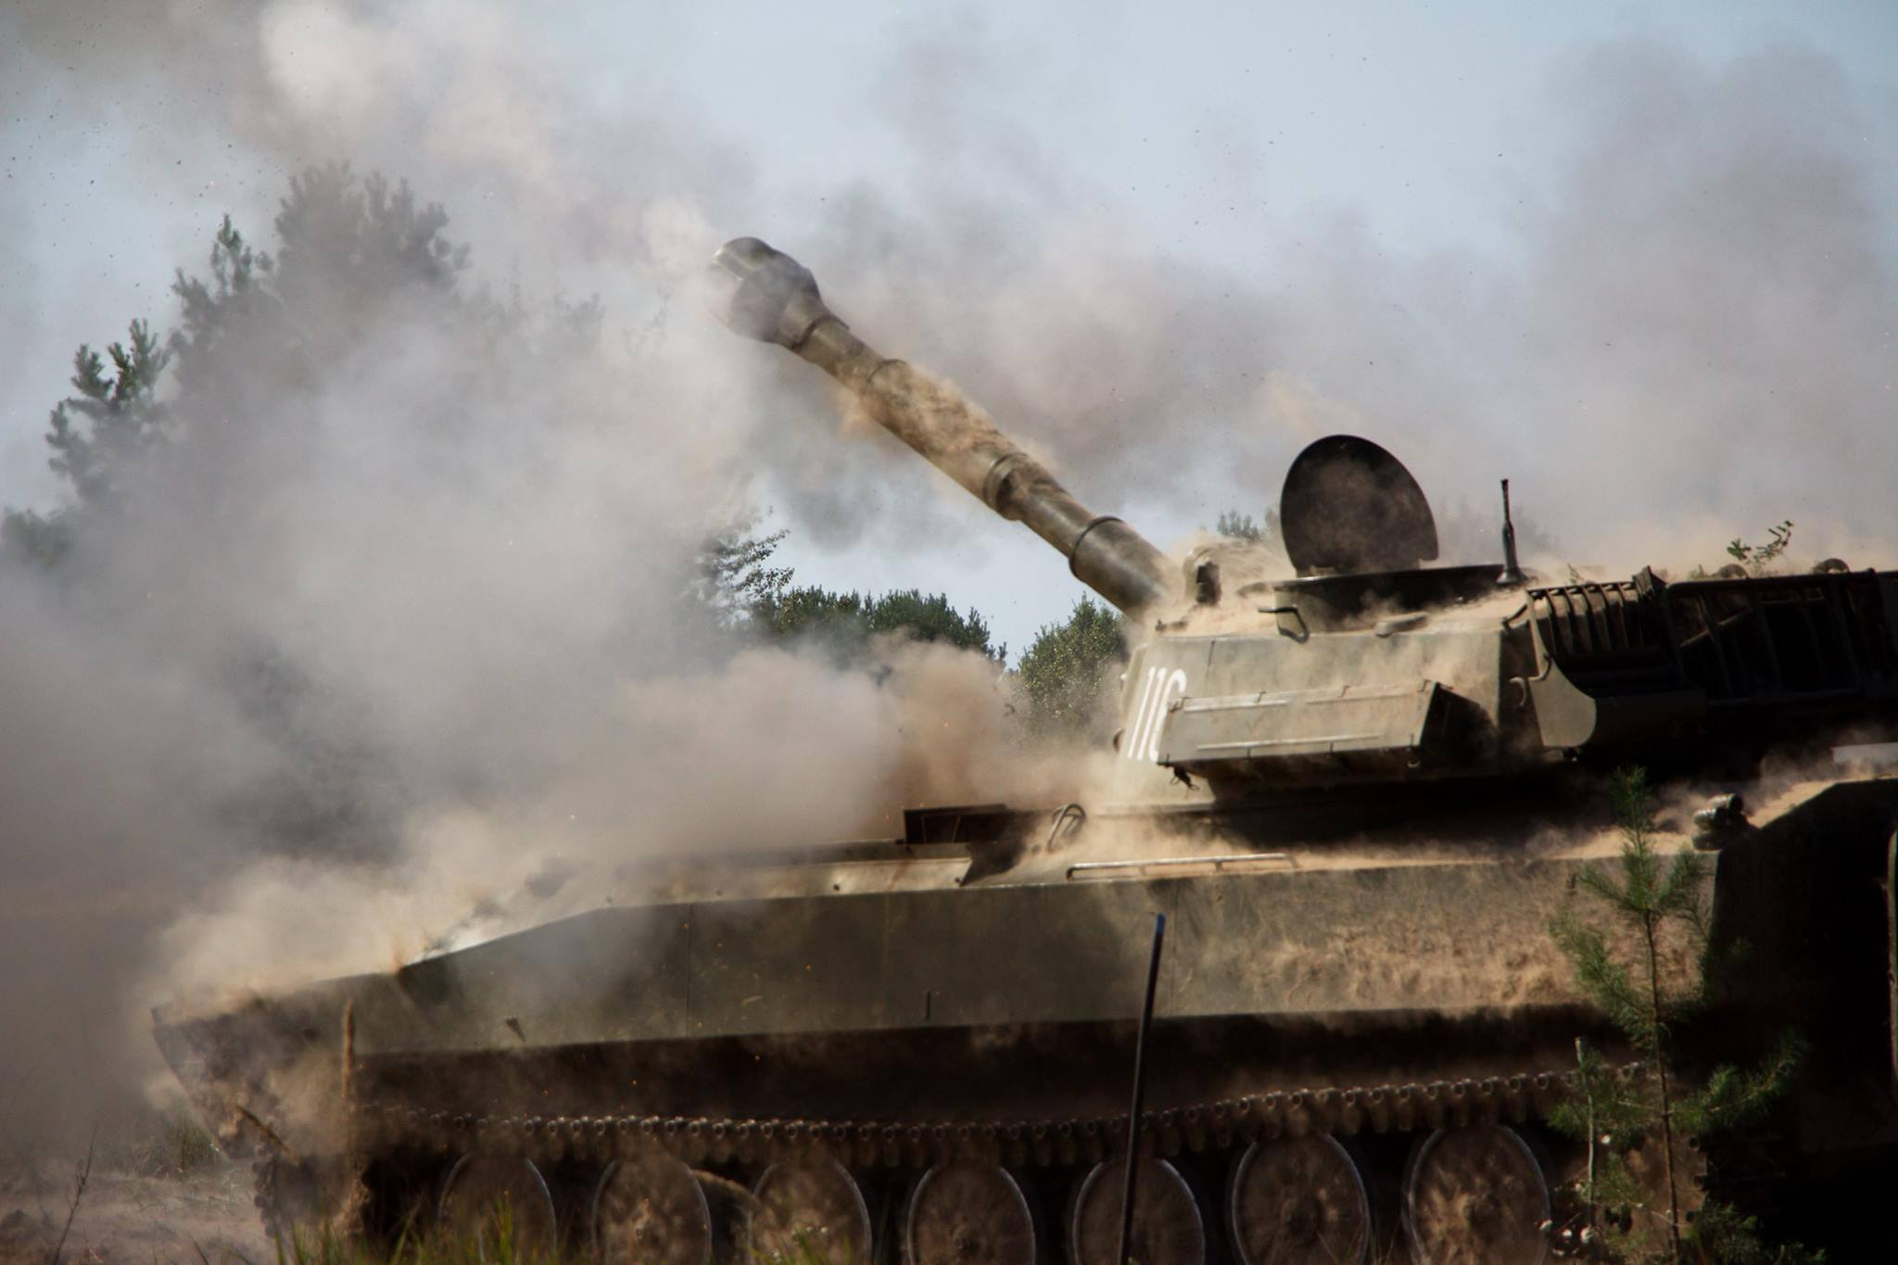
Demo
In the demo app we will simulate operation of an artillery battery which would consist of 6 howitzers

Slide 7
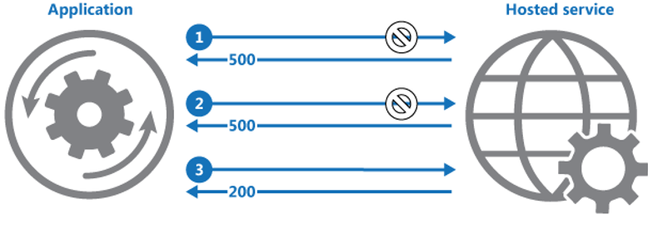
Recap. Retry
When to use – on transient faults.
Variations:
Immediate retry
Retry with back off
Retry with back off and jitter

Slide 8
Recap. Timeout
When to use:
With long running operations which do not have built-in timeout.
Variations:
Optimistic (relies on CancellationToken and co-operative cancellation)
Pessimistic (does not rely on cancellation tokens, just walks away)
Additional considerations:
Always think of abandoned tasks. Any actions as they are successful/faulted/cancelled ?

Slide 9
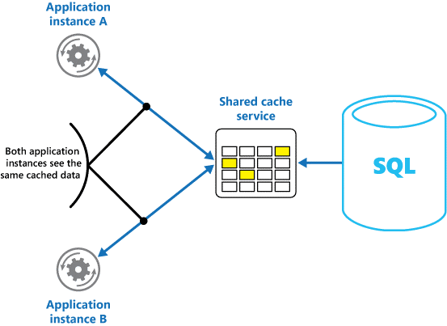
Recap. Cache
When to use:
When working with relatively static data
When cache does not have native read-through and write-through support
Consider:
Implementing distributed cache (see picture)

Slide 10
Recap. Fallback
When to use:
When you actually have a fall back strategy.
Keep in mind:
It does not matter what your delegate actually does, is it a request, DB query, or some thing else. It can be literally anything.

Slide 11
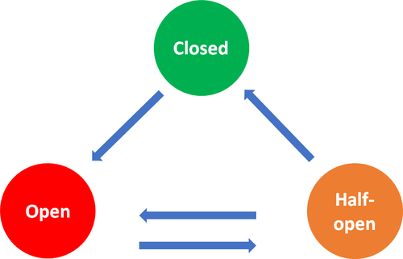
Recap. Circuit breaker
When to use:
When you have a lot of requests to the same destination within short period of time.
Consider:
Distributed circuit breaker – makes circuit breakers in scalable systems way more effective, but there are a lot of additional complexity and interesting questions

Slide 12
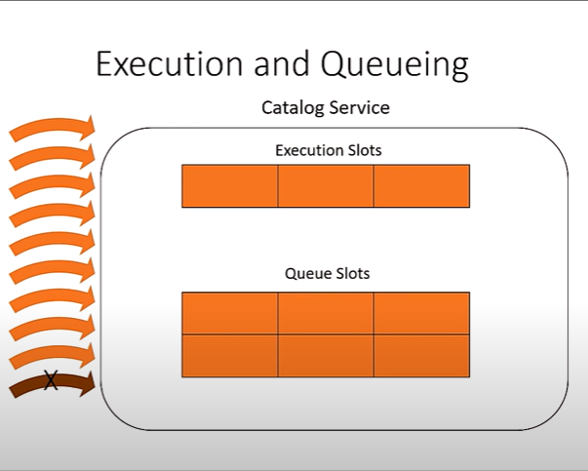
Recap. Bulkhead
When to use:
When “request” handling costs a lot of resources (memory, sockets, CPU).
Do not use “blindly”. Measure what is the “comfort zone” of your apps in appropriate environments.

Slide 13
Recap. Testing with Simmy
When to use:
When you want to test your policies.
When you want to test your services or even entire system for resiliency.
When you are in the mood to experiment.

Slide 14
Further learning
Polly
Simmy
Polly-Contrib
https://docs.microsoft.com/en-us/azure/architecture/patterns/
https://docs.microsoft.com/en-us/dotnet/architecture/cloud-native/application-resiliency-patterns
Bryan Hogan talk at NDC conference

Slide 15
Used nugets
Polly:
https://github.com/App-vNext/Polly
https://github.com/App-vNext/Polly.Caching.MemoryCache
Polly-Contrib:
https://github.com/Polly-Contrib/Polly.Contrib.WaitAndRetry
https://github.com/Polly-Contrib/Simmy
GRPC:
https://github.com/protocolbuffers/protobuf
https://github.com/grpc/grpc
DI:
https://autofac.org/
“Console on steroids”:
https://github.com/bilal-fazlani/CommandDotNet
Fake data gen:
https://github.com/bchavez/Bogus
Coordinates calculation:
https://github.com/scottschluer/geolocation

Slide 16
Questions?

Slide 17
Thank you!

